Slide 1


Project on
World Wide Energy Consumption
Presented by :
Name : B. Bhanu Sai Prakash
Batch No : 436
Branch : Dilsukhnagar

Slide 2

About me
I am Bhanu Sai Prakash Bandaru.
I completed my B.Tech in Computer Science and Engineering from M.V.G.R College of Engineering(Vizianagaram).
Linkedin : https://www.linkedin.com/in/bhanu-sai-prakash-bandaru-22a1b8204/
Github : https://github.com/bhanusaiprakashbandaru

Slide 3

Agenda
Introduction
Business Problem Statement
Objectives
ER Diagram & Schema Explanation
Tables and Fields
SQL Analysis and Query Results
Key Insights & Recommendations
Conclusion
Q&A

Slide 4

Introduction
Energy production, consumption, and carbon emissions vary widely across countries.
Economic growth, population size, and energy sources strongly influence these differences.
Rising global energy demand makes understanding these relationships essential.
This project analyzes global data on energy, emissions, GDP, and population using SQL.
The analysis focuses on identifying global patterns, country-wise differences, and long-term trends.

Slide 5

Business Problem Statement
Energy companies work with multiple energy sources such as coal, oil, gas, and renewable energy to meet electricity demand. As population and economic activity grow, energy consumption increases, which also leads to higher carbon emissions.
For organizations like NTPC Limited, it is important to understand how different energy sources contribute to energy supply, emissions, and economic growth over time. Without clear analysis, it becomes difficult to identify high-emission energy sources, measure efficiency, and plan cleaner and more sustainable energy strategies.
This project uses SQL to analyze global energy, emission, population, and GDP data to generate insights that can support better energy planning and emission reduction decisions.

Slide 6

Objective
To design a structured database model that organizes global energy, emission, population, and GDP data
To establish clear relationships between datasets using country and year for accurate analysis
To analyze energy production and consumption patterns across different energy sources such as coal, oil, gas, and renewables
To study carbon emission trends and identify major energy sources contributing to emissions
To examine how population growth and economic growth influence energy usage and emissions
To evaluate energy efficiency using emission-to-GDP and consumption-to-GDP ratios
To identify long-term trends and countries that have shown improvement in emission levels
To generate meaningful insights that support efficient and sustainable energy planning

Slide 7
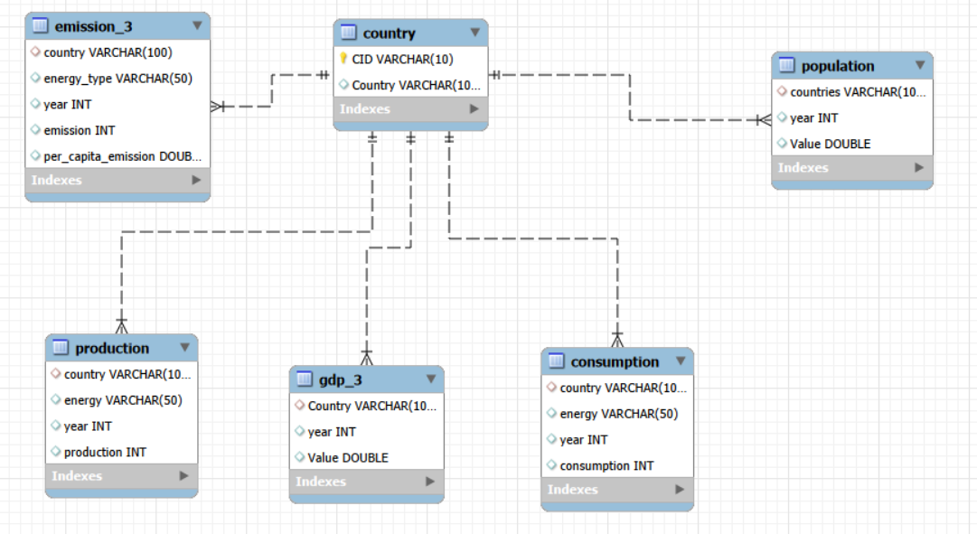
ER Diagram & Schema Explanation

Slide 8

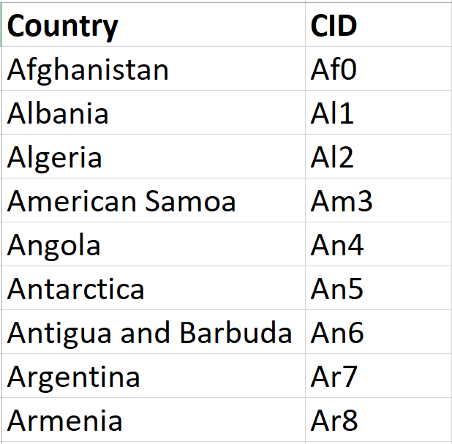
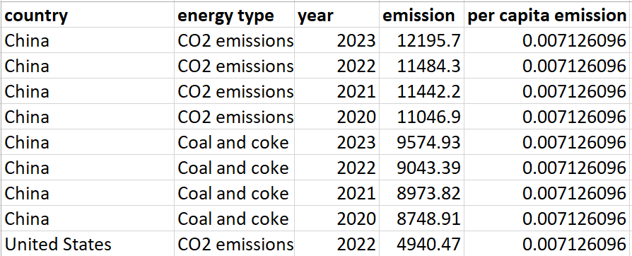
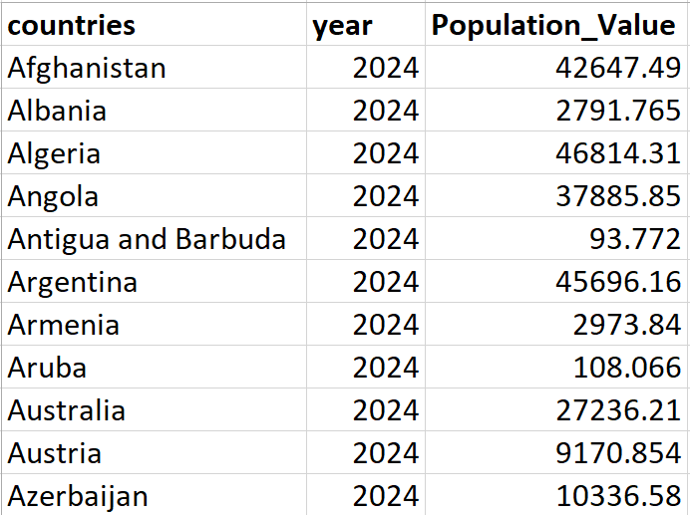
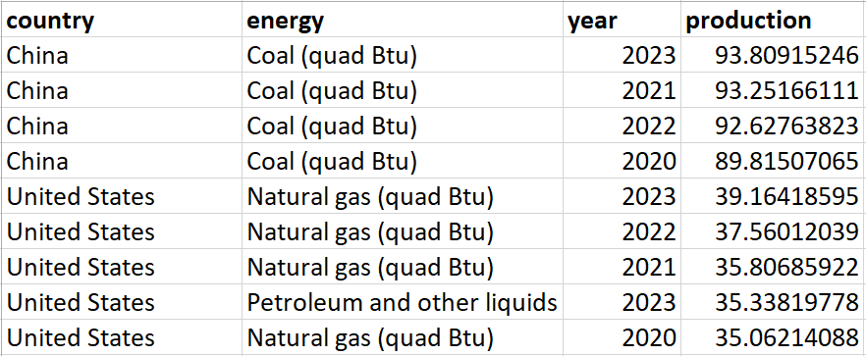
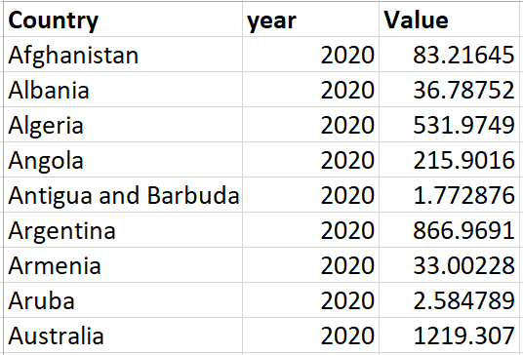
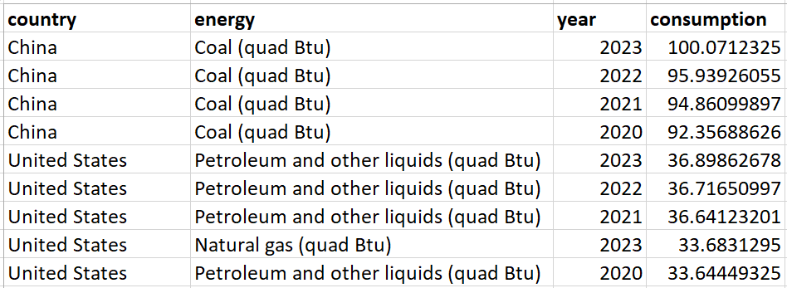
Tables and Fields
Country Table
Emission Table
Population Table
Production Table
GDP Table
Consumption Table

Slide 9

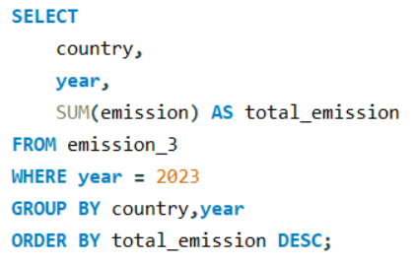
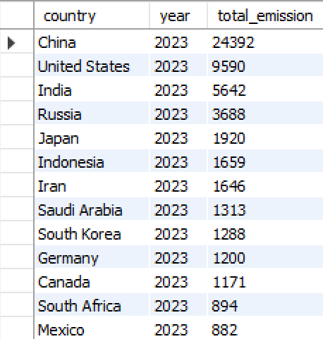
SQL Analysis and Query Results
What is the total emission per country for the most recent year available?
Query
Output

Slide 10
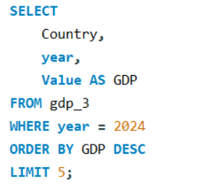
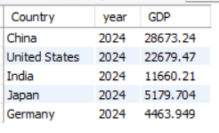
SQL Analysis and Query Results
What are the top 5 countries by GDP in the most recent year?
Query
Output

Slide 11
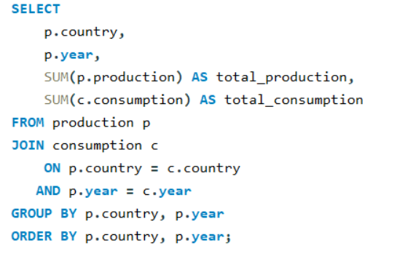
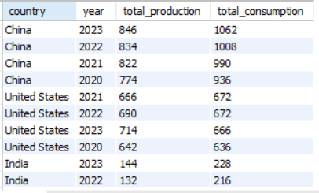
SQL Analysis and Query Results
Compare energy production and consumption by country and year.
Query
Output

Slide 12
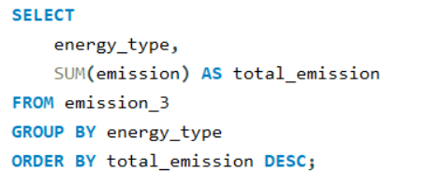
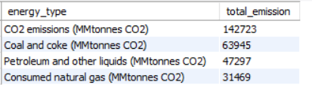
SQL Analysis and Query Results
Which energy types contribute most to emissions across all countries?
Query
Output

Slide 13
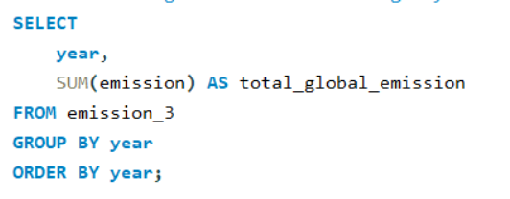
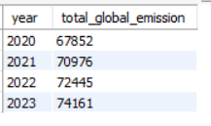
SQL Analysis and Query Results
How have global emissions changed year over year?
Query
Output

Slide 14
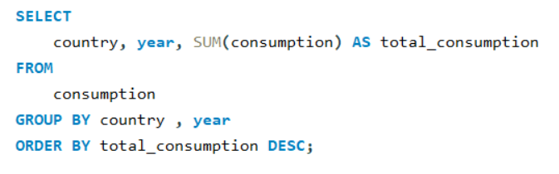
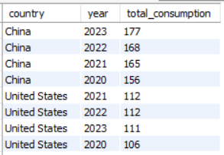
SQL Analysis and Query Results
Has energy consumption increased or decreased over the years for major economies?
Query
Output

Slide 15
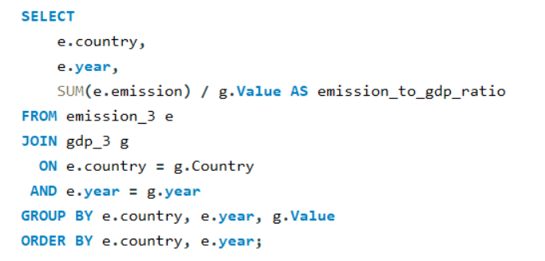
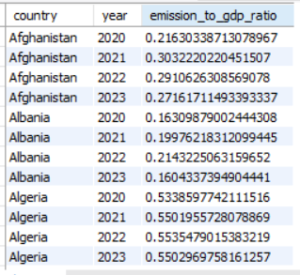
SQL Analysis and Query Results
What is the emission-to-GDP ratio for each country by year?
Query
Output

Slide 16
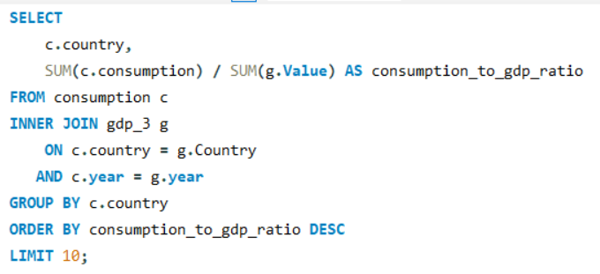
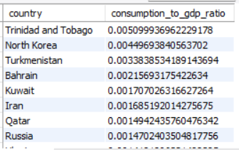
SQL Analysis and Query Results
Which countries have the highest energy consumption relative to GDP?
Query
Output

Slide 17
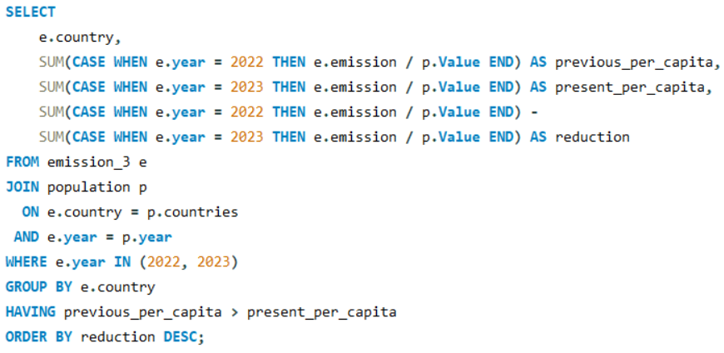
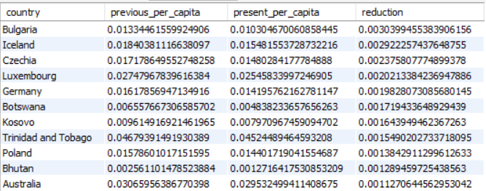
SQL Analysis and Query Results
Which countries have improved (reduced) their per-capita emissions the most over the last decade?
Query
Output

Slide 18
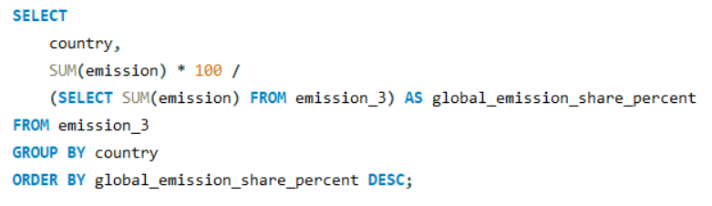
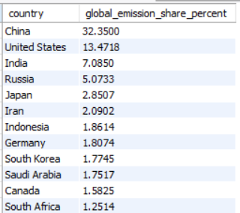
SQL Analysis and Query Results
What is the global share (%) of emissions by country?
Query
Output

Slide 19

Key Insights & Recommendations
Key Insights
A small number of countries contribute most of the global carbon emissions.
Higher economic growth often leads to higher emissions, but efficiency differs by country.
Coal and coke are the largest contributors to carbon emissions among energy sources.
Global emissions have increased over time due to rising energy demand.
Some countries consume more energy than they produce, showing energy dependency.
A few countries have reduced per-capita emissions, proving improvement is possible.
Recommendations
Power sector organizations such as NTPC Limited should reduce dependence on coal and increase cleaner energy sources.
Countries with high emissions relative to GDP should improve energy efficiency.
Emission trends should be tracked regularly using data-driven analysis.
Best practices from countries that reduced emissions should be adopted for sustainable planning.

Slide 20

Summary page
Conclusion
This project analyzed global energy, emission, population, and GDP data using SQL. A well-structured database design enabled accurate analysis across countries and years.
The analysis revealed a strong relationship between energy usage, economic growth, and carbon emissions. Total CO₂ emissions remain high globally, and among individual energy sources, coal and coke contribute the most to emissions. At the same time, differences across countries show that improved energy efficiency and better planning can help reduce emissions.
Overall, this project demonstrates how SQL can transform raw data into meaningful insights that support data-driven decision-making for sustainable energy and emission management.
Notes:
textbox
No alt text provided
textbox
No alt text provided
textbox
No alt text provided
textbox
No alt text provided
textbox
No alt text provided
textbox
No alt text provided
textbox
No alt text provided
textbox
No alt text provided
actionButton
No alt text provided

Slide 21
?
Any
Questions

Slide 22

Thank you

